Slide 1
At-Home Sleep Staging Device
Progress Presentation
Presented by: Kiron Sukesan
Team Members: Matthew Hwang, Yinong Wang
Clients: Dr. Lucey and Dr. Ju
Mentor: Dr. Moran
Notes:
Hi, my name is Kiron Sukesan. My group members are Matthew Hwang and Yinong Wang and we’re working on the At-Home Sleep Staging device. Our Clients are Dr. Lucey and Dr. Ju and our mentor Dr. Moran.

Slide 2
Project Overview and Need
Scope
  Design an EEG-based device for use in a home setting
  Can accurately record and store sleep EEG data over the course of multiple nights.
  must incorporate occipital lobe EEG
Need
  A cheaper and more convenient solution to sleep staging information
    as opposed to a clinical sleep study
  Access a greater patient population
Notes:
Before we get started lets have a quick refresher of our the Need and Scope of our project.
To paraphrase our scope our project goal is to build an EEG based device that can be used in a home setting that stores EEG data while a patient sleeps
We hope this project will provide a cheaper and more convenient method to gain access to staging information. Hopefully this device can be used a screening tool for patients that are unable or unwilling to perform a clinical sleep study

Slide 3
Two Components of Design
Electrode Design
  Interface with the skin
Headset Design
  For placement and stability of the electrodes
Notes:
For the design of our device, there were two major components that we looked at. The design of the electrodes that are used to pick up EEG signal and the Design of the headset that will hold these electrodes in place during the night. These components are mutually exclusive and they were evaluated separately

Slide 4
Design Specifications For Electrodes
Electrode-to-skin impedance of less than 50 kΩ
Comfortable
  Directly interfacing with the skin
Easy to use
  Patients will be unsupervised when using the devices
Notes:
We’ll first look at the electrode design. When we were evaluating different electrodes major criteria we considered was whether.…

Slide 5
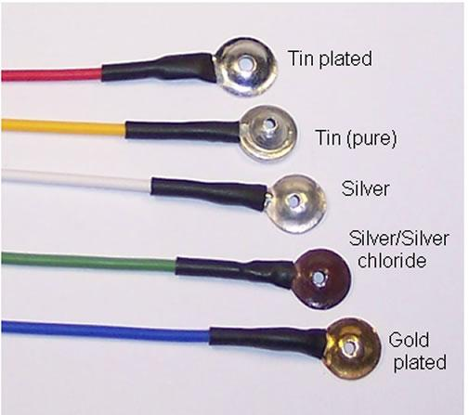
Wet Electrodes
Typically used in EEG applications
Relatively low cost
  Reusable ($8-10/electrode)
  Gel needs to be replaced
Require gel placement for conductivity through the hair
  Trained technician
Patients would be sleeping with gel
  Uncomfortable
Source: https://wiki.engr.illinois.edu/download/attachments/44733160/Cup+Electrode3.jpg?version=1&modificationDate=1292305757000
Notes:
Wet electrodes are the standard in EEG
they’re called wet electrodes because they require conductive gel to be placed between the electrode and the surface of the patients skin
Usually a technician applies the gel to ensure proper application. It’s difficult to apply the gel correctly to your own head, because it generally works best if the gel is applied perpendicular to the surface of the scalp.
Because wet electrodes are so prevalent, they are relatively cheap. For reusable electrodes, they cost about $8-10 dollars. some examples of these are shown on the right. Disposable electrode are about 50 cents

Slide 6
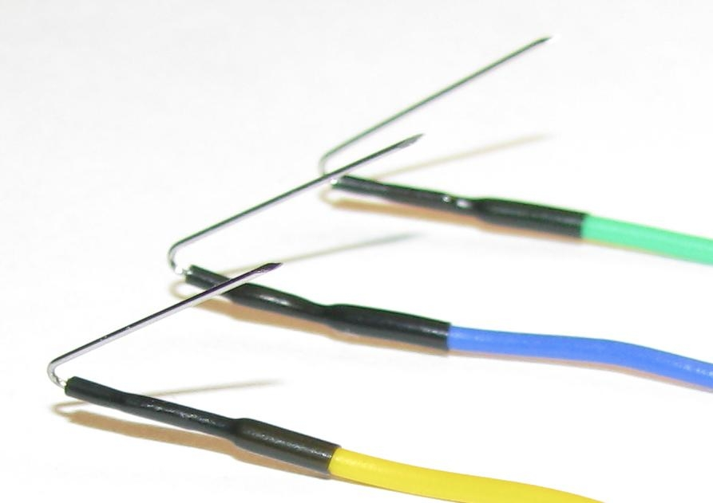
Needle Electrodes
A lot of impedance is due to oils on the surface of the skin and hair
  Needle electrodes eliminate this by going under the epidermal layer of the skin
Difficult for patients to apply themselves
Because piercing the skin
  Prone to Infection
Unsafe to sleep on, can break easily
Non reusable ($3-20/electrode)
Source: http://rhythmlink.com/uploads/cms/Pictures/PressReleaseImages/2010PressReleaseImages/Bent%20Needles.JPG
Notes:
Another electrode type are needle electrodes
The idea with needle electrodes is to avoid a lot of the impedence caused by the hair and oils the skin by going under the skin.
This works in a lab setting with a trained technician, but is very unsafe for patients in their homes.
To apply these electrodes you need to pierce skin, which leaves patients suspectible to infection. And to make matters worse, these electrodes can rbeak under the skin if pressure is applied to them. During a night’s sleep this seems like a possibility and therefore caused us some hesitation with this solution
Needle electrodes are also not reusable for sterilization purposed and cost about 3 to 20 dollars per electrode.

Slide 7
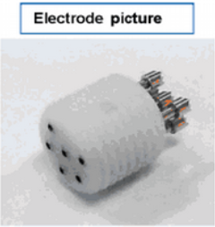
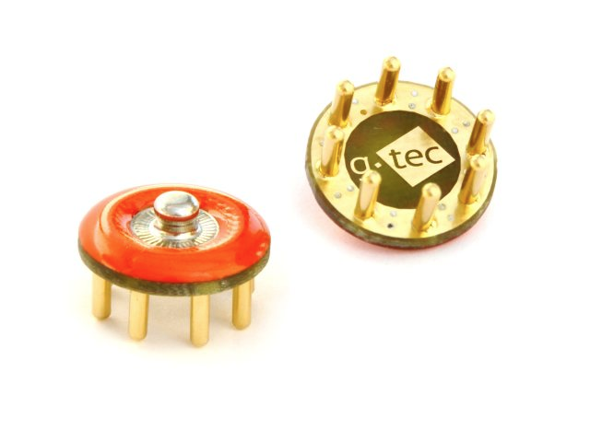
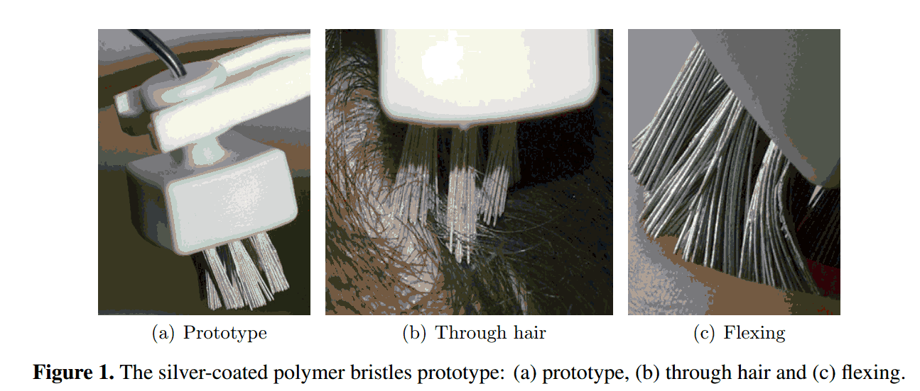
Dry Electrodes
They follow a similar idea:
Extruding conductive pins that can fit through the hair
Sources: http://www.gtec.at/var/plain_site/storage/images/media/images/products/g.sahara/gsaharastandard/26514-1-eng-GB/gSAHARAstandard.jpg
Notes:
The third solution we considered were dry electrodes.
For a long time people were looking for a dry electrode that could be used to take EEG data for convenience but the biggest problem was finding a way to get through the patient’s hair, which has very high impedance. Recently the actual solution to this problem has been found. There are a lot of recent patents on dry electrodes but they all follow the same general idea, which is to have extruding pins that can fit through the hair and get in direct contact with the scalp.

Slide 8
Dry Electrodes
Do not require gel
  Easier to set up than wet and needle electrodes
Completely Reusable
Fairly recent advancement in technology
  Not commercially available and will be more expensive
For the g.SAHARA dry electrode
  the cost for the system is approximately $300-500 for 8 electrodes
Pins are thin and though flexible, they may be uncomfortable to sleep directly on
Notes:
In consideration of our design dry electrodes look pretty good because they do not require gel, and are much easier to set up than needle or wet electrodes
however they are a fairly recent advancement in technology and they they are not commercially produced to they are very expensive to get ahold of.
Also because they rely on thin conductive pins, they may be uncomfortable to sleep on.
And just to get an idea of cost, the g. sahara electrodes are pictured here and they cost between 300 and 500 dollars for 8 electrodes

Slide 9
Electrode Pugh Chart
Category | Weight | Wet Electrodes | Needle Electrodes | Dry Electrodes
Signal Quality | 7 | 8 | 10 | 7
Comfort | 8 | 8 | 1 | 7
Price | 4 | 10 | 8 | 3
Ease of Use | 10 | 4 | 3 | 10
Safety | 8 | 8 | 1 | 8
Total |  | 264 | 149 | 281
Notes:
when we were making the pugh chart we decided to prioritize Safety, comfort and ease of use. Safety because this is the component our device directly interfacing with the patient, comfort because is it important that patients be able to sleep with the device, otherwise the device would serve no purpose. Easy to use was also prioritized because this device is aimed to be used without any help, unlike a clinical sleep study.
And as you can see from this analysis, even though the wet electrodes are cheaper and have a lower impedance, the convenience of the dry electrodes make them worth it.

Slide 10
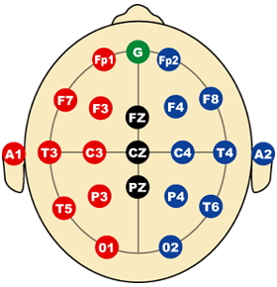
Design Specifications for Headset
Provides occipital coverage and frontal coverage and preferably access to CZ for reference
Stabilizes electrodes to ensure that they will not fall off during the night
Adjustable for different head sizes
Comfortable
Easy to use
Minimally invasive
Source: http://www.immrama.org/eeg/electrode.html
Notes:
So moving on to the second component of our design which is design of the headset.
When we considered possible designs for the headset, we had these specifications in mind.
Our headset needs to have occipital and frontal lobe coverage and perferable should have access to Cz for reference
The intent of our headset is to stabilize the electrodes so they would not fall off during the night
Also we wanted to make sure our headset was adjustable to accomadate all head size
it should be comfortable
easy to use
and minimally invasive

Slide 11
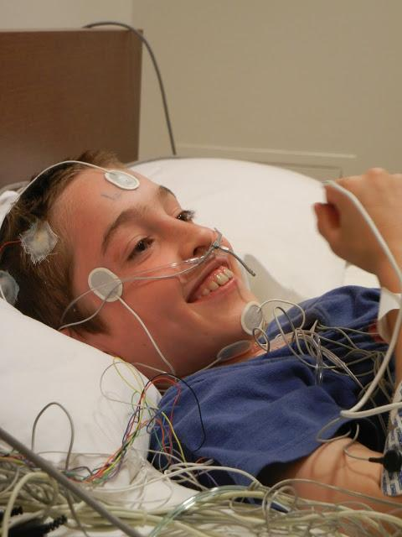
Individual Electrodes
Taped to patient’s head
Placed by physician
Easily moved out of place
Wiring issues
Source: http://glimpseofpeace.blogspot.com/2011/06/prognosis-juvenile-sleep-study.html
Notes:
In clinical sleep studies individual electrodes are taped to the patient’s head by the sleep technician. They need to be placed correctly so ensure correct coverage. Unfortunately they can fall off during the night.

Slide 12
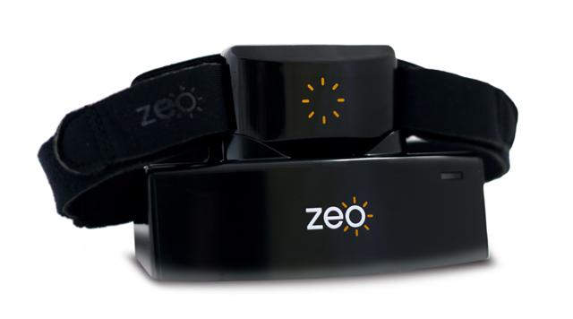
Single Headband
Very simple
Has a tendency to fall off during the night
Frontal and occipital coverage
Source: http://www.shinyshiny.tv/zeo-sleep-manager.jpg
Notes:
The simplest design solution has actually already been implemented with a similar device called the zeo. By just attaching electrodes to a headband we would get access to both frontal and occipital regions. But, because it is so minimal, this device had problems staying on the patient’s head

Slide 13
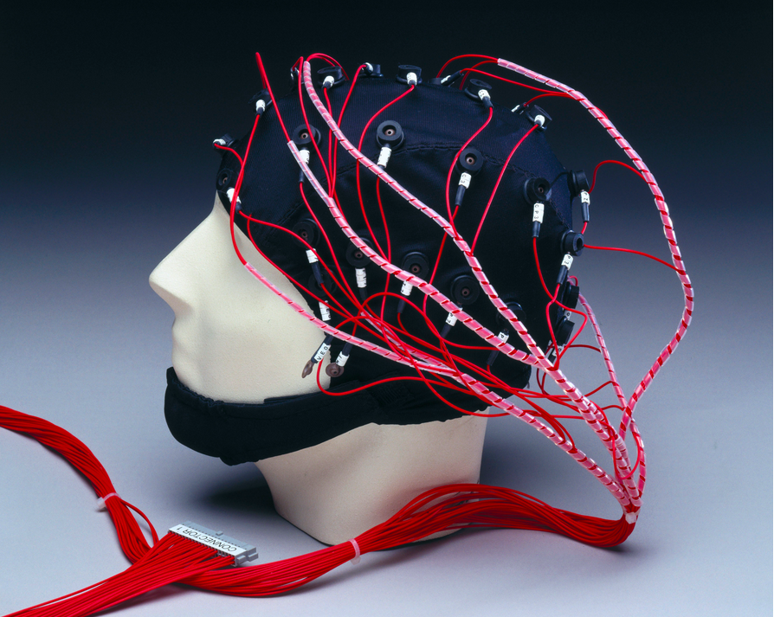
EEG Cap
Excellent coverage
Good stability during the night
Not very comfortable
http://blog.sciencemuseum.org.uk/talkscience/files/2012/04/EEG-Cap.jpg
Notes:
Another typical way to hold electrodes in place is use an EEG cap. It’s pictured here and it basically covers the whole head and provides excellent coverage and gives good stabliity but it’s not very comfortable.

Slide 14
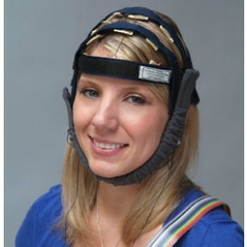
Double Headband
Provides frontal, occipital and access to CZ
minimally invasive
Relatively comfortable
Fairly stable
Sources: http://bio-medical.com/products/neuroband-19-channel-qeeg-headband.html
Notes:
One idea we had to alleviate some of the problems of the single headband was to add a second headband perpendicular to the first that would go below the patients chin to stabilize the electrodes and provide good coverage. This picture isn’t exactly what we had in mind, but it illustrates the idea we’re going for. Use a minimal amount of material while still having sufficient coverage and stability.

Slide 15
Other Solutions
Helmet to cover entire head
  Very stable but not comfortable
Hammock
  Holds the patients head in place
Wraparound Pillow
  cushioning on three sides of the head
Notes:
We had several other solutions but for the interest of time i’ll just touch on a few more of them briefly.
we considered using a helmet to cover the head, but while this increased stability it seemed very uncomfortable
The hammock was a more novel idea of ours where a mesh hammock would be placed on a patients headrest and would hold the patients head suspended slightly in the air. Electrodes would be inbedded in the hammock and would provide occipital coverage
The wraparound Pillow would be cover the back and sides of the patient’s head. the pillow would be strapped around the forehead of the patient and would let you sleep on your side and well as your back.

Slide 16
Pugh Chart for Headset Design
Category | Weight | Wraparound Pillow | Single Headband | EEG Cap | Helmet | Beanie | Double Headband | Individual Electrodes | Hammock
Comfort | 8 | 7 | 10 | 7 | 4 | 7 | 9 | 4 | 6
Stability | 9 | 7 | 5 | 10 | 9 | 6 | 9 | 1 | 7
Adjustability | 8 | 5 | 9 | 6 | 1 | 4 | 10 | 1 | 7
Ease of Use | 10 | 9 | 10 | 7 | 9 | 10 | 9 | 3 | 5
Coverage | 7 | 5 | 8 | 10 | 10 | 6 | 10 | 10 | 5
Total |  | 284 | 353 | 334 | 281 | 284 | 393 | 149 | 252
Notes:
This is our pugh chart for the analysis of our design. For the headset we prioritized ease of use and stabilty and comfort the most. with these weights the double headband seemed to be the best solution.

Slide 17
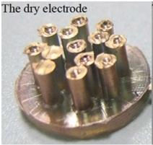
Specific Design
Circuitry on the top of the head
  Flash Memory
    2 GBs
    micro SD
  Arduino
Dry Electrodes
  Many options
  3D printing for prototyping
ADS1299 Instrumental Amplifier

Slide 18
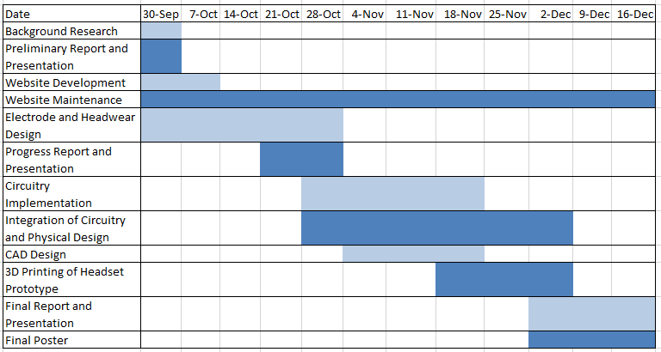
Design Schedule

Slide 19
Team Responsibilities
 | Yinong | Matthew | Kiron
Webmaster |  | X
Electrical Circuit Design |  | X | X
Component Sources | X | X
Structural Design | X
Signal Design |  | X
Electrode Design |  |  | X
Mentor Liaison | X |  | X
Structural Modeling | X |  | X

Slide 20
Questions?

