Slide 1
At Home Sleep
Stage Monitor
Team Members: Yinong Wang, Kiron Sukesan, Matthew Hwang
Clients: Dr. Brandon Lucey and Dr. Yo-El Ju
Mentor: Dr. Daniel Moran
Notes:
My name is Yinong Wang, and I am working as part of Group 29 with Kiron Sukesan and Matthew Hwang to design an at home sleep stage monitor.
Our clients are Dr. Lucey and Dr. Ju, neurologists at the WashU Sleep Center.
Our mentor is Dr. Moran.

Slide 2
Background on Sleep
Sleep has been studied for a very long time, but its function has yet to be fully elucidated
Although its importance is unquestioned, many theories have been formulated to explain the phenomenon
Energy storage
Restoration of tissues and growth
Thermoregulation
Emotion regulation
Neural maturation
Memory and learning
Source: http://www.drsharma.ca/wp-content/uploads/sharma-obesity-sleeping-snoopy.jpg
Notes:
1. Conservation of energy: stores energy for increased energy consumption during sleep deprivation and decreased basal metabolism during sleep.
2. Restoration of tissues and growth: hormone excretion, cell mitosis, and protein synthesis are increased during the first few hours of sleep. (increased NREM)
3. Thermoregulation: long-term sleep deprivation causes an increase in body temperature. (10 degrees in rats)
4. Emotion regulation: SWS deprivation results in depressive or hypochondriacal states (anxiety), and NREM likely serves to regulate these emotions.
5. Neural maturation: REM sleep likely associated with the maturation of the brain and myelination of nerve fibers.
6. Memory and learning: fixation of memory traces during sleep between the cortex and hippocampus.

Slide 3
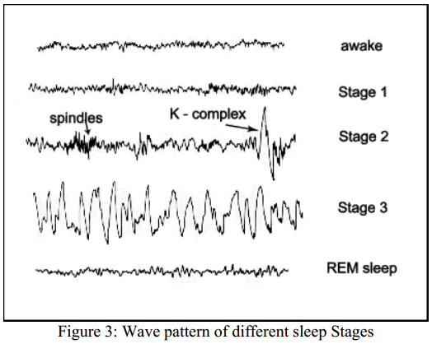
Stages of Sleep
By American Academy of Sleep Medicine (AASM) standards there are 5 stages of sleep
Wakefulness
REM (Rapid Eye Movement)
Three non-REM stages
N1 - High alpha attenuation
N2 - Theta, spindles, K-complexes
N3 (SWS) - High amplitude delta
Source: Susmakova, K. "Human Sleep and Sleep EEG." Measurement Science Review. 4 (2004): 59-74. Web. 25 Sept. 2013.
Notes:
Wake: 8-13 Hz alpha rhythm in the Occipital region
REM: often associated with dreaming and muscle atonia to prevent the “acting out” of dreams/nightmares; irregular, rapid breathing, increased heart rate; “deeper sleep”
low voltage, “sawtooth” waves
Increased depth of sleep from N1 to N3, denoted by the increase in peak-to-peak amplitude of the waves, but an overall decrease in frequency. N1: 4-7 Hz range, sharp vertex waves, easily disrupted
N2: These bursts of oscillatory brain activity: sleep spindles, 11-16 Hz, and/or K complexes, large sharp wave, both lasting at least 0.5 seconds
N3: 0.5-2 Hz, peak-to-peak amplitude of >75 uV from the Frontal regions

Slide 4
Clinical Benefits of Staging Sleep
Sleep acts as an indicator for overall health
Serves as an excellent tool for diagnosing sleep disorders
Changes in sleep behavior is a risk factor for the development of many diseases
Notes:
So what are the benefits of staging our sleep--or quantifying the amount of time we spent in each stage of sleep?
Sleep disorders, over 40 million chronic sufferers in the USA, most commonly insomnia, sleep apnea, RLS, and narcolepsy
Using tools of measurement such as a respiratory effort monitor alongside an EEG monitor, sleep disorders such as sleep apnea can be diagnosed
Increased levels of inflammatory response hormones
Elevated risk for heart disease and stroke
May be an early indicator for the development of neurological disorders such as Alzheimer’s or Parkinson’s Disease

Slide 5
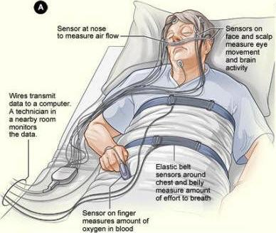
Modern Sleep Studies
Incorporates many data acquisition methods
EEG
EOG
EMG (chin)
EKG
Respiratory
Pulse Oximetry
Source: http://www.nhlbi.nih.gov/health/health-topics/images/sleep_studies.jpg
Notes:
Full sleep studies typically include nearly 20 EEG electrodes applied via conductive gel, EOG, EMG (on the chin), EKG for heart rate, spirometer for respiration, pulse oximetry for blood oxygen levels, CPAP (continuous positive airway pressure) for maintaining airflow for patients with certain disorders.

Slide 6
Problem
Sleep studies that exist today are inconvenient for the patient
Cost is a huge deterrent
They need a good screening tool that can give them staging information
Notes:
Need to go to sleep study center for overnight observation, require the help of a technician to set up a plethora of recording devices.
Costs the patient at least $1,000/night. average price in us ~$2600
If more in depth sleep studies need to be done, this device can be a good screening tool to easily examine their sleeping patterns.

Slide 7
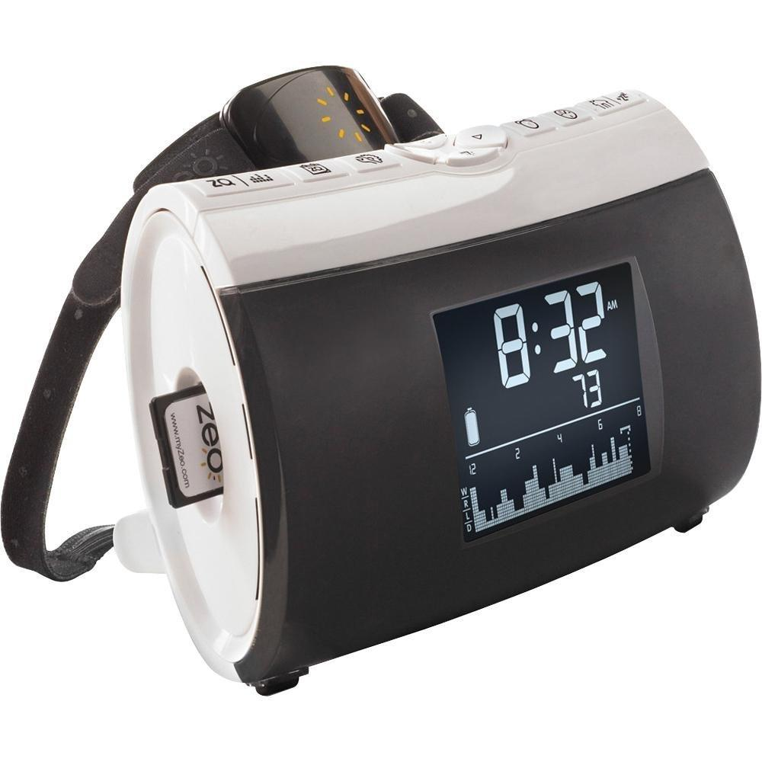
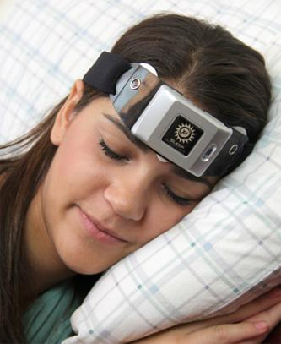
Existing Devices
Zeo Sleep Manager
Sleep Profiler
Source: http://www.amazon.com/Zeo-ZEOBP01-Personal-Sleep-Manager/dp/B002IY65V4/ref=sr_1_1?ie=UTF8&qid=1380517941&sr=8-1&keywords=zeo+sleep+manager
Source: http://www.medgadget.com/2012/10/sleep-profiler-a-personal-night-watchman-for-your-sleep.html
Notes:
There are only a couple devices that aim to attempt to solve the problems mentioned previously.
The Zeo, which is no longer sold due to the company’s financial troubles, consists of a small headband with the attachment of three dry electrodes on the frontal lobe (or forehead). This $200 device came paired with a “base station” charging station, which served as an alarm clock to wake up the user when he/she is in the lightest stage of sleep in order to minimize wake fatigue and it served as a means of analyzing the raw EEG data through the use of an frequency domain algorithm. These data were collected and uploaded to the company’s website, where the user could freely examine their sleep behavior and learn how they can improve it. This device has been validated as 80% accurate by comparing their algorithmic scoring methods to the gold standard, visual scoring, by which a trained technician manually designates 30 second epochs of EEG as a particular stage of sleep throughout the night. Their algorithm is good, but researchers cite that it has some issues determining wake and N1 due to the lack of its ability to pick up on alpha waves. Unfortunately all of the online services provided have been shut down, so the device cannot be used as a consumer device.
The Sleep Profiler by Advanced Brain Monitoring, which has been marketed as more of a clinical research device, functions in a similar manner. It’s validation studies show a similar level of agreement with visual scoring compared to that of the Zeo. Has an average battery life that will suffice for two nights of sleep monitoring. The device costs $4,000, which is a very large cost for monitoring sleep.
It is important to note that our clients have used both of these devices in their clinical studies.

Slide 8
Scope
Design an EEG-based device for use in a home setting and can accurately record and store sleep EEG data over the course of multiple nights. This device must incorporate occipital lobe EEG coverage and should allow patients and clinicians to download and view the data. The device should also be more affordable than a sleep study to patients.

Slide 9
Design Specifications - Circuitry
Maximum electrode impedance | 50 kΩ
Digital resolution | > 12 bits/sample
Sampling rate | > 200 Hz
Frequency range | 0.3 - 35 Hz
Amplifier gain | 100 - 100,000
Amplifier CMRR | > 100 dB
Input impedance | > 100 MΩ
A/D converter resolution | < 0.5 µV
Notes:
i think most important thing to talk about in this slide is the electrode impedance and the frequency range + resolution, they can read the rest

Slide 10
Design Specifications
Ability to store sleep data on device for minimum of 3 days
Can transmit data to external storage for data analysis
Can record EEG data from the frontal lobe and occipital lobe at minimum
Comfortable for patient to wear during the night
Stable design so that electrodes do not move around during sleep
Easy for patient to set up at night and to remove in the morning

Slide 11
Preliminary Analysis
Sampling rate = Nyquist rate
Frequencies of interest: 0.3 Hz - 35 Hz
Nyquist rate = 2 x highest frequency of interest
= 2 x 35 = 70 Hz minimum

Slide 12
Preliminary Analysis
Onboard memory capacity with 12-bit resolution:
1.5 GB of storage space will be sufficient for at least 3 days of EEG data.
Notes:
note that this is worst case situation recording all day

Slide 13
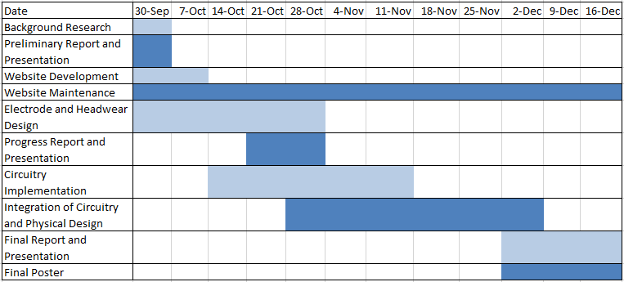
Design Schedule

Slide 14
Team Organization
 | Yinong Wang | Matthew Hwang | Kiron Sukesan
Webmaster |  | X
Electrical Circuit Design |  | X | X
Component Sources | X | X
Structural Design | X
Signal Design |  | X
Electrode Design |  |  | X
Mentor Liaison | X |  | X
Structural Modeling | X |  | X

Slide 15
Questions?

